Slide 1
Pipelining

Slide 2
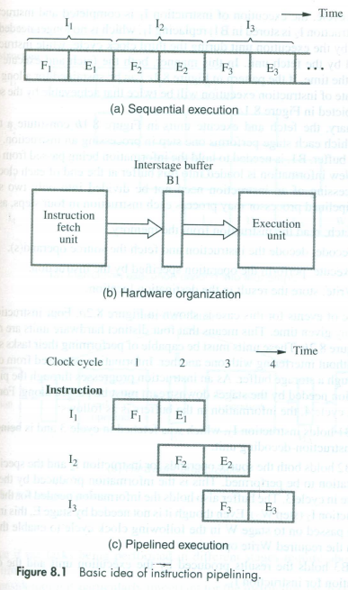
Concepts
To improve performance
→use faster circuit technology to build processor and main memory.
→Arrange the H/W so that more than one operation can be performed at the same time.
Pipelining Example-Fig 8.1
→Two stage pipeline(Fetch, Execute)
→Four stage pipeline(Fetch, Decode, Execute,Write)
Fig 8.2

Slide 3
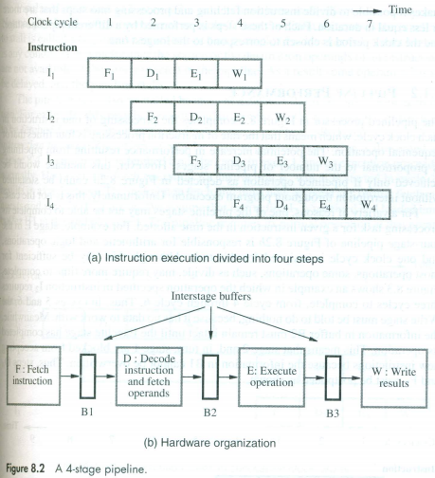

Slide 4
Role of Cache memory
Each stage in one CC(assumption)
Hence clock period should be long to complete the task being performed in any stage(longest task).
Example IF from memory and Register fetch.(Problem)
Overcome by using Cache Memory.

Slide 5
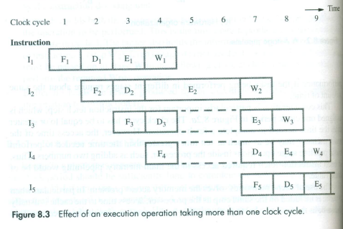
Pipeline Performance
→Some instructions may take more than one clock cycle to execute like divide
→Stall →hazard
Data hazard(Example)
Control/Instruction hazard→Stall can be due to delay in availability of instn( Cache miss)
Structural hazard—Two instruction competing for same H/W resources

Slide 6
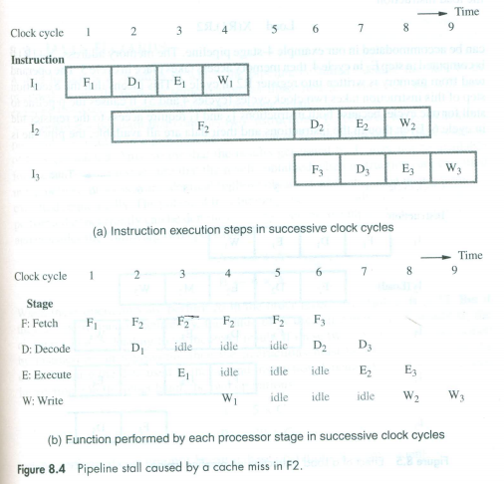

Slide 7
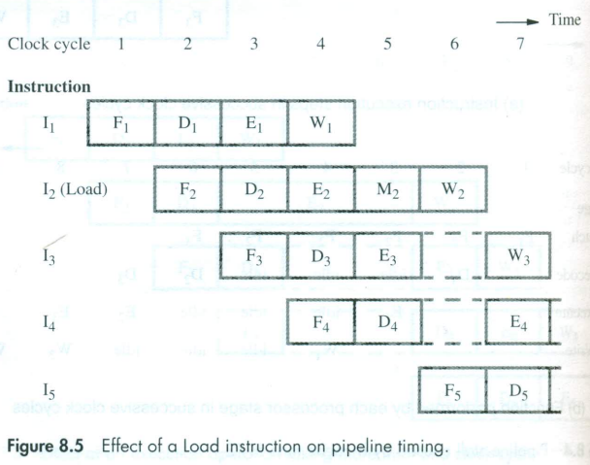
Load X(R1),R2 I2, I3 try access reg in CC 6
Structural Hazards are avoided by having sufficient hardware resources

Slide 8
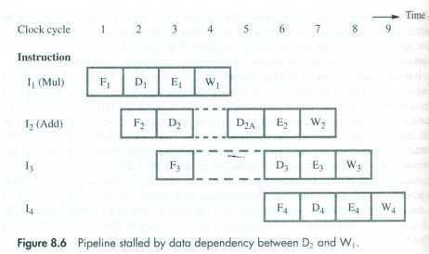
Data Hazards
Examples
Dependent instruction
(A←3+A, B←4*A)
Independent instruction
(A←5*C, B←20+C)
Timing Diagram
Mul R2,R3,R4
ADD R5,R4,R6

Slide 9
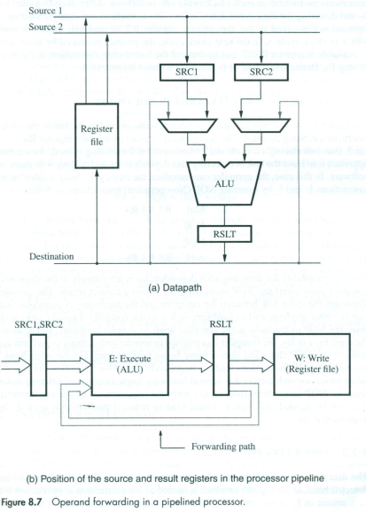
Operand Forwarding

Slide 10
Handling data hazards in software
Stalls encountered at hardware level will degrade the performance
To avoid h/w level stalls S/W instructions are used.
Example
Mul R2,R3,R4
NOP
NOP
ADD R5,R4,R6
Reordering of instruction

Slide 11
Side Effects
Auto increment and Auto decrement
Alters both Source and destination
Stack PUSH and POP
Implicitly use auto increment and decrement
Condition Code
Condition branch and Add with carry ADD(R1,R2),(R3,R4)
Add R1,R3
AddwithCarry R2,R4
R4←[R2]+[R4]+CARRY.

Slide 12
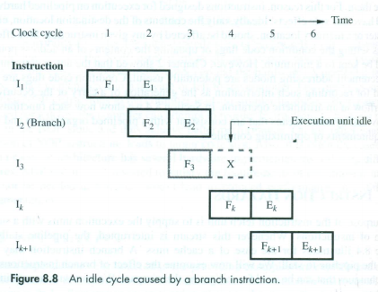
Instruction Hazards-Unconditional Branches
One CC Penalty

Slide 13
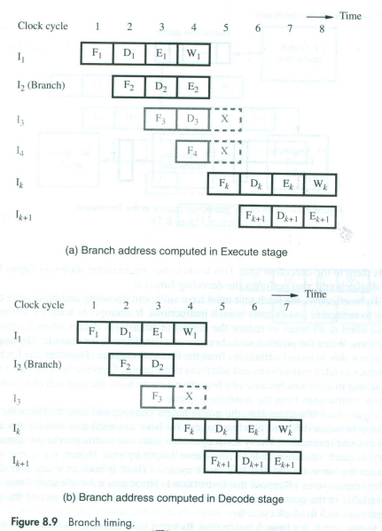
2 CC Delay
BTA is calculated in Decode stage

Slide 14
Instruction Queue and Prefetching
Either the cache miss or a branch instruction stalls the pipeline for one or more CC.
To reduce stall many processors employ sophisticated fetch units that can fetch instructions before they are needed and put them in a queue.
Dispatch unit fetch the instns from front of the queue and sends them to EU

Slide 15
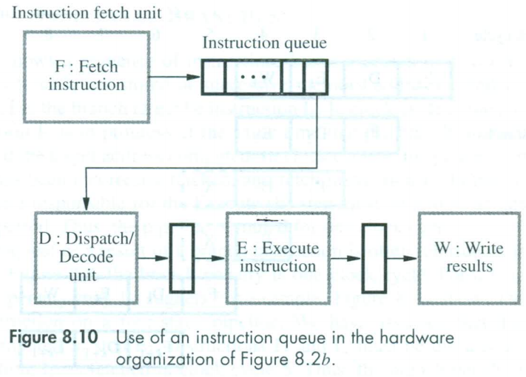
Instruction Queue and Prefetching

Slide 16
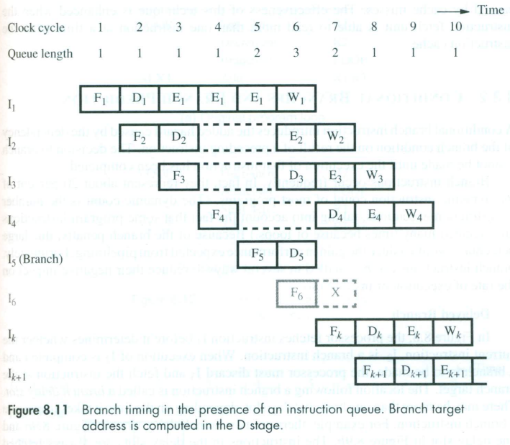
Avoids Stall
→Branch instn doesn’t increase overall execution time
→Because IF has executed the branch instn and other instn concurrently (Branch folding)
→Branch folding occurs only if when branch occurs there is atleast one instn in queue other than branch

Slide 17
Conditional branches and branch prediction
20% of instn are branches
Location following branch is branch delay slot
Techniques to reduce branch penalty (Static branch prediction-decisions are fixed(taken/NT))
Delayed branching
Branch prediction
Logical errors should not happen

Slide 18
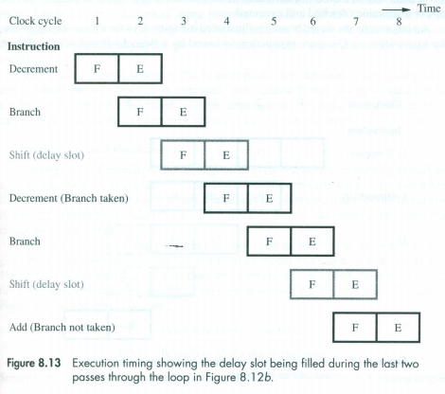
Delayed branch
Original Program
LOOP Shift_left R1
Decrement R2
Branch=0 LOOP
NEXT Add R1,R2
Reordered Instructions
LOOP Decrement R2
Branch=0 LOOP
Shift_left R1
NEXT Add R1,R2

Slide 19
Branch Prediction
Assume branch is not taken
Fetch sequential instn
Start execution on speculative basis(Speculative execution: instns are executed before the processor is certain that they are in the correct execution sequence)
Mispredicted unroll
Inorder Commit

Slide 20
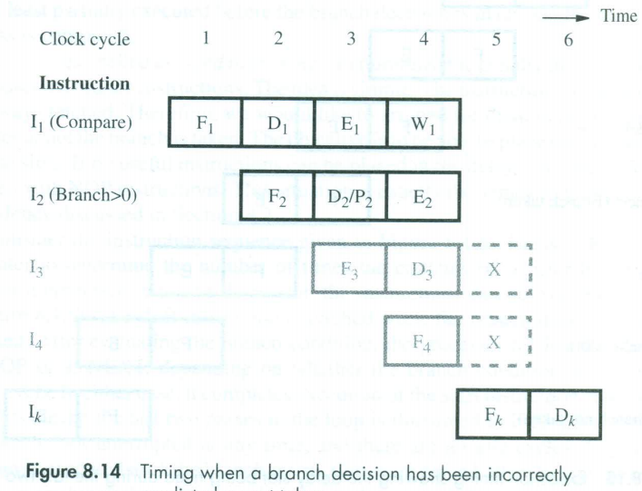
Example for misprediction

Slide 21
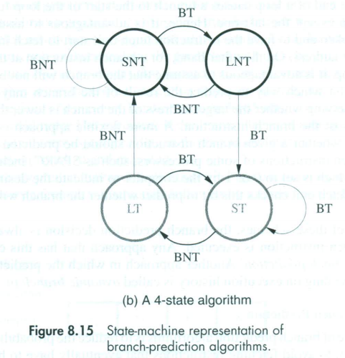
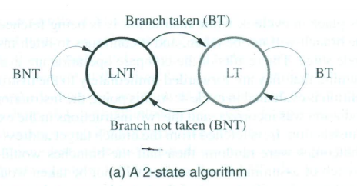
Dynamic prediction
LT→Likely to be taken
LNT→Likely not be taken
ST→Strong Taken
SNT→Strong Not taken

Slide 22
Influence on Instruction Sets
Load X(R1), R2 →Takes 5 CC
Load (R1), R2 →Takes 4 CC
Load (X(R1)), R2 →Complex addressing mode

Slide 23
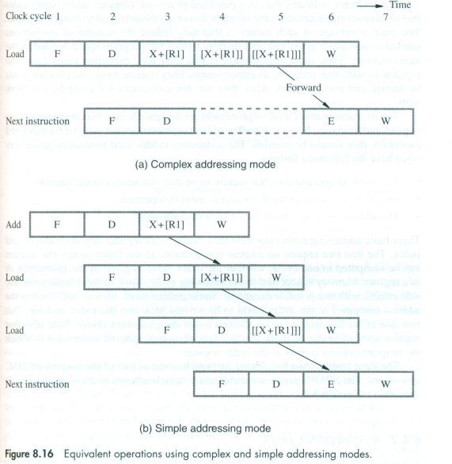
ADDRESSING MODES
Load (X(R1)), R2
ADD #X,R1,R2
LOAD (R2),R2
LOAD (R2),R2

Slide 24
ADDRESSING MODES(AM)
Complex addressing mode involving multiple memory access do not necessarily lead to faster execution.
Complex AM advantage
→Reduce number of instns
→Reduce program space
Complex AM disadvantage
→long execution time cause stalls
→Thus reduce effectiveness
→Need more H/W to decode and execute them.

Slide 25
Features of AM used in modern processor
Access to an operand doesn’t require more than one access to the memory.
Only LOAD and STORE instruction access memory operand.
The addressing modes used do not have side effects
AM having this feature are
→Register, register indirect and Index

Slide 26
Condition Codes
Reordering of instructions by compiler
The dependency introduced by condition codes reduces the flexibility of instruction reordering.
Handling of condition codes
To provide flexibility in reordering instructions, the condition code flags should be affected by as few instns as possible.
The compiler should be able to specify in which instn of program the condition codes are affected and in which they are not.

